Slide 1
July 18th Meeting
Ainsley Lai

Slide 2
Agenda
Comparing identical repeated rows with different instance IDs
Same speed (and hopefully range) SPDFs
Full Duration Spectrogram (and extended timeframe)
Rx level over Speed
Getting data from AIS data
Eastern Caldera

Slide 3
Comparing identical repeated rows with different instance IDs

Slide 4
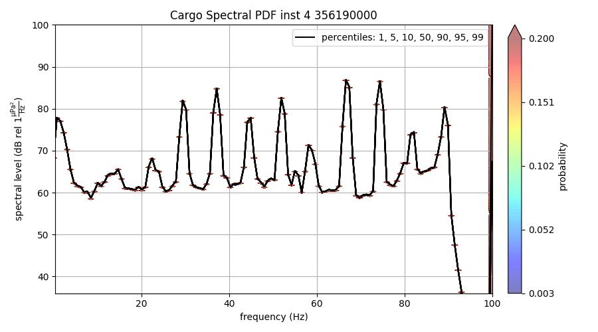
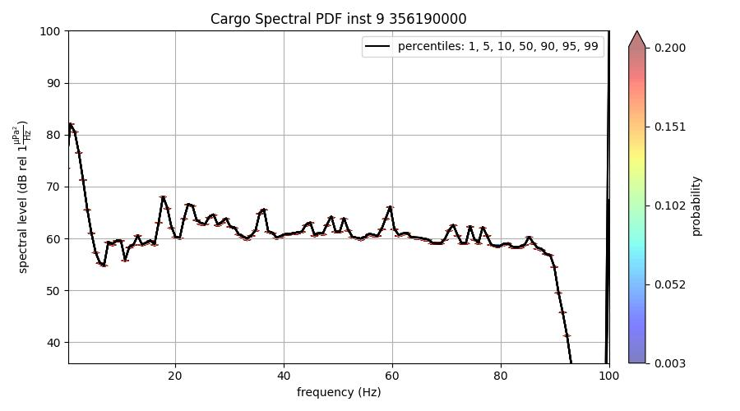
MMSI 356190000 CC
Same row data, different instance ID

Slide 5
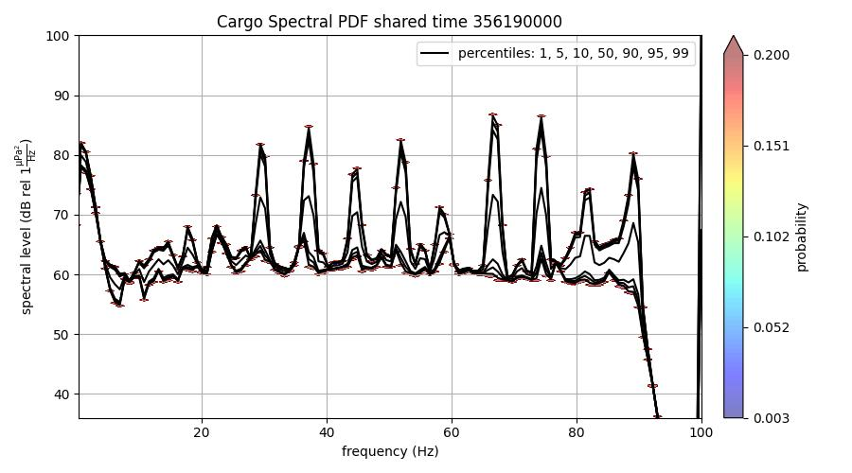
MMSI 356190000 CC
Same row data, different instance ID
Plotted on the same SPDF

Slide 6
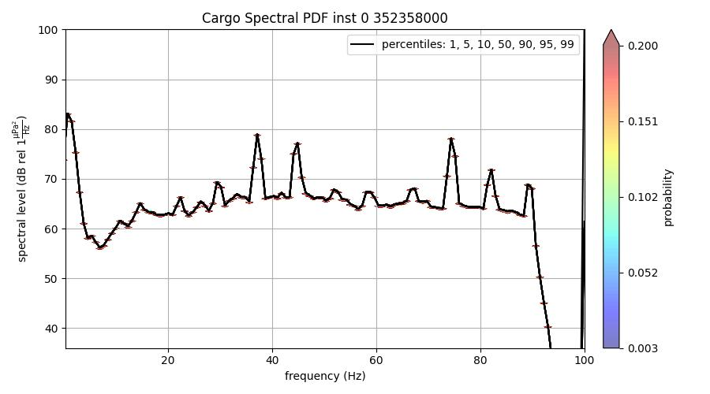
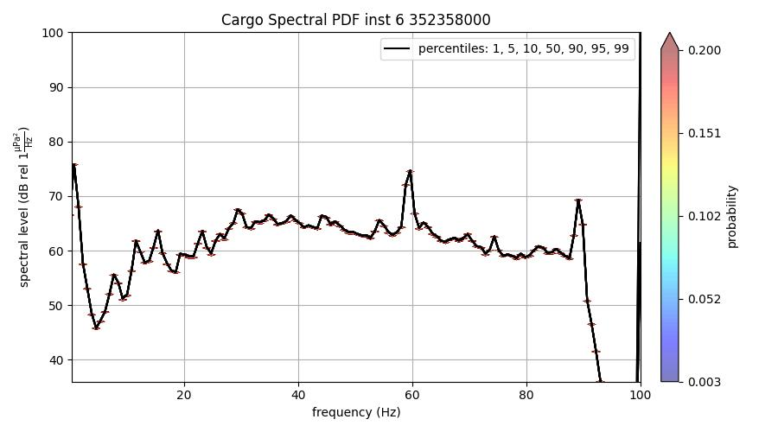
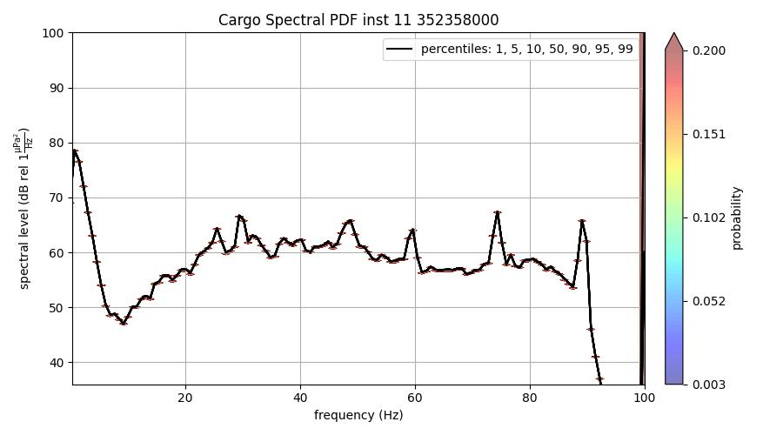
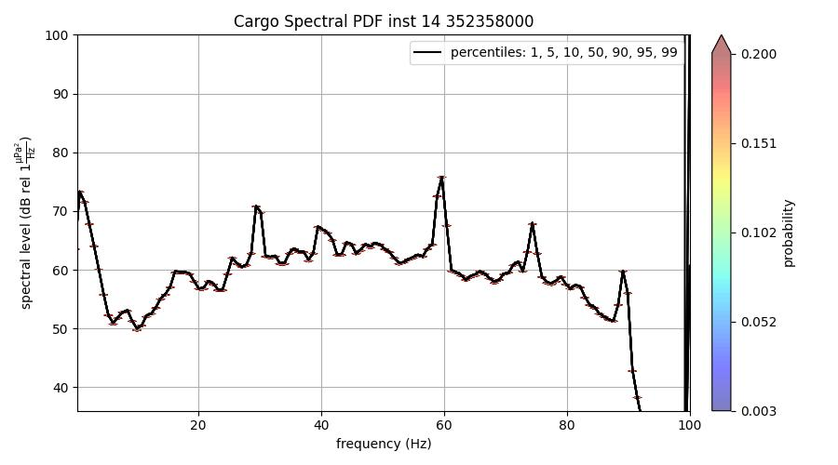
MMSI 352358000 AB
Same row data, different instance IDs

Slide 7
Same speed (and hopefully range) SPDFs

Slide 8
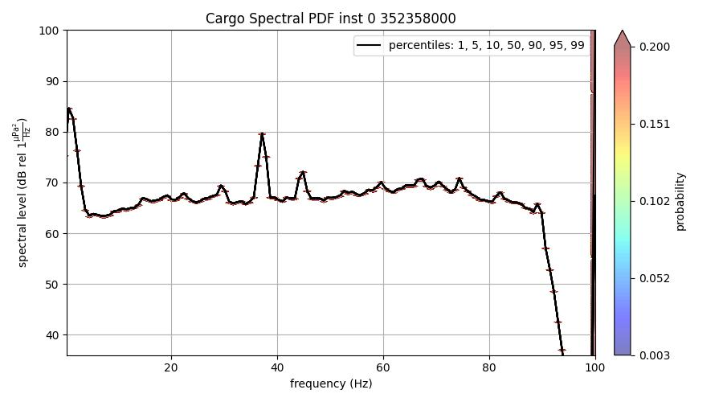
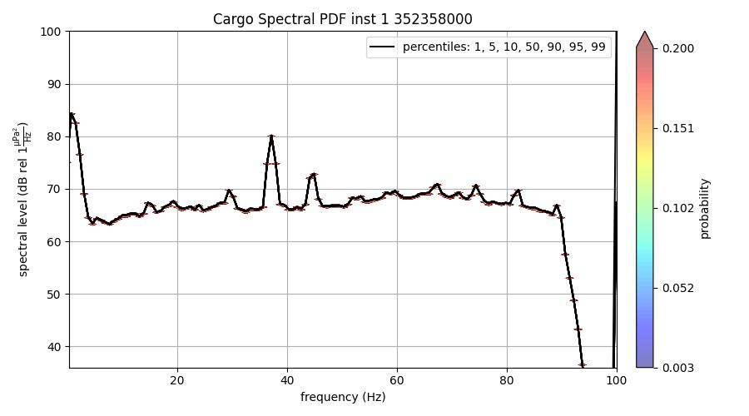
MMSI 356190000 CC
Speed: 3 knots
Range: 4.28 km
Speed: 2.9 knots
Range: 4.09 km

Slide 9
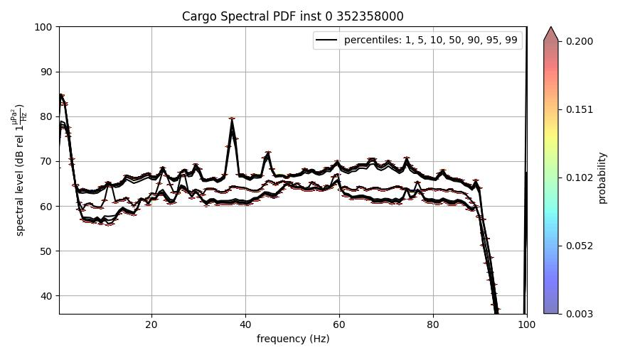
MMSI 356190000 CC
Same row data, different instance ID
Adjusted to use all the repeated rows for this speed + range combination
Speed: 3 knots
Range: 4.28 km
Speed: 2.9 knots
Range: 4.09 km

Slide 10
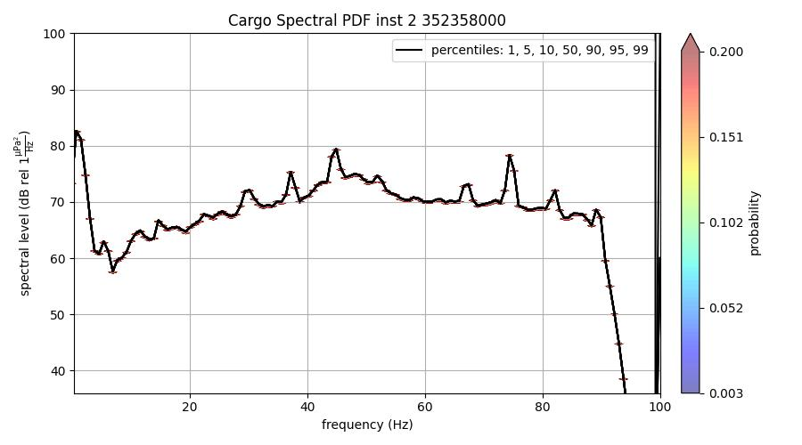
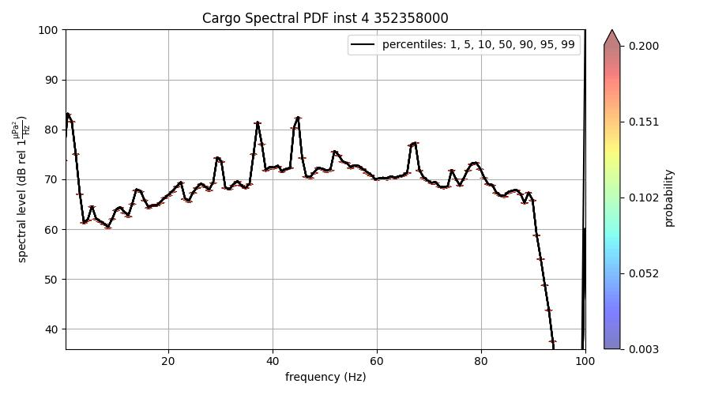
MMSI 352358000 AB
Speed: 2.2 knots
Range: 1.85 km
Speed: 2.2 knots
Range: 1.89 km

Slide 11
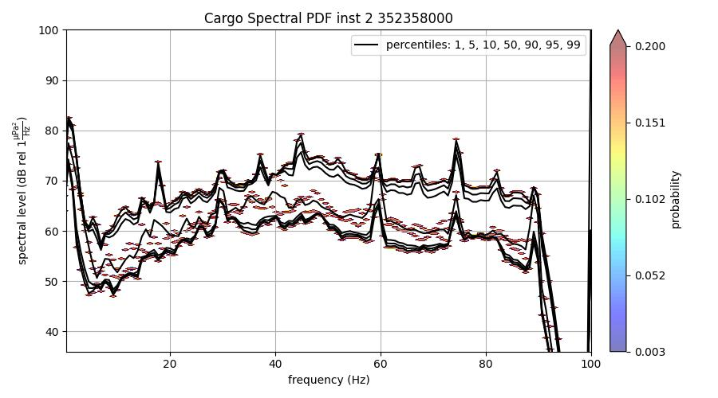
MMSI 352358000 AB
Including repeated rows
Speed: 2.2 knots
Range: 1.85 km
Speed: 2.2 knots
Range: 1.89 km

Slide 12
Full Duration Spectrogram (and extended timeframe)
Using Khirod’s data

Slide 13
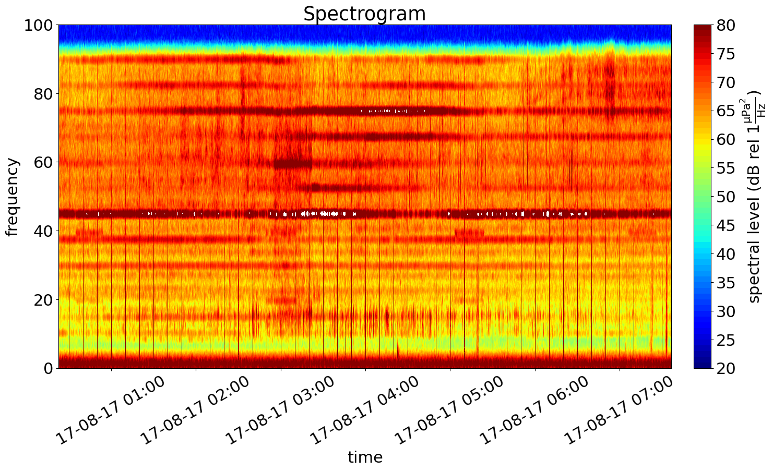
MMSI 356190000 AB
Start: 03:22:52
End: 05:37:51
3 hours before start and end

Slide 14
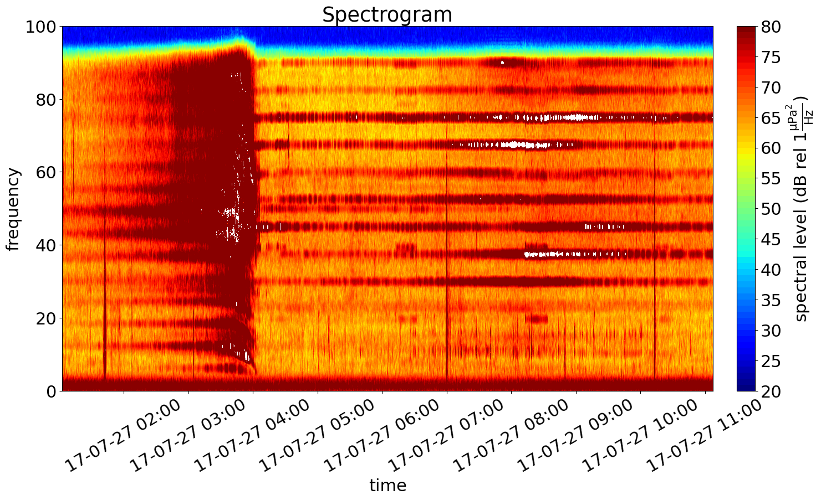
MMSI 356190000 CC
Start: 04:02:56
End: 08:07:23
3 hours before start and end

Slide 15
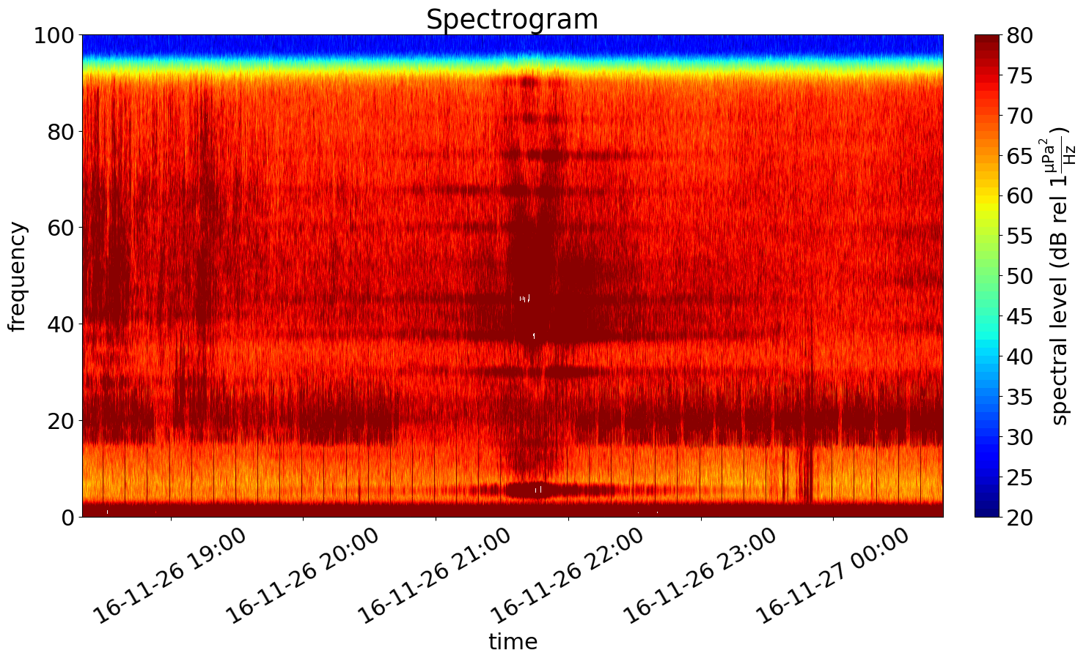
MMSI 538005544 AB
Start: 21:20:06
End: 21:49:48
3 hours before start and end

Slide 16
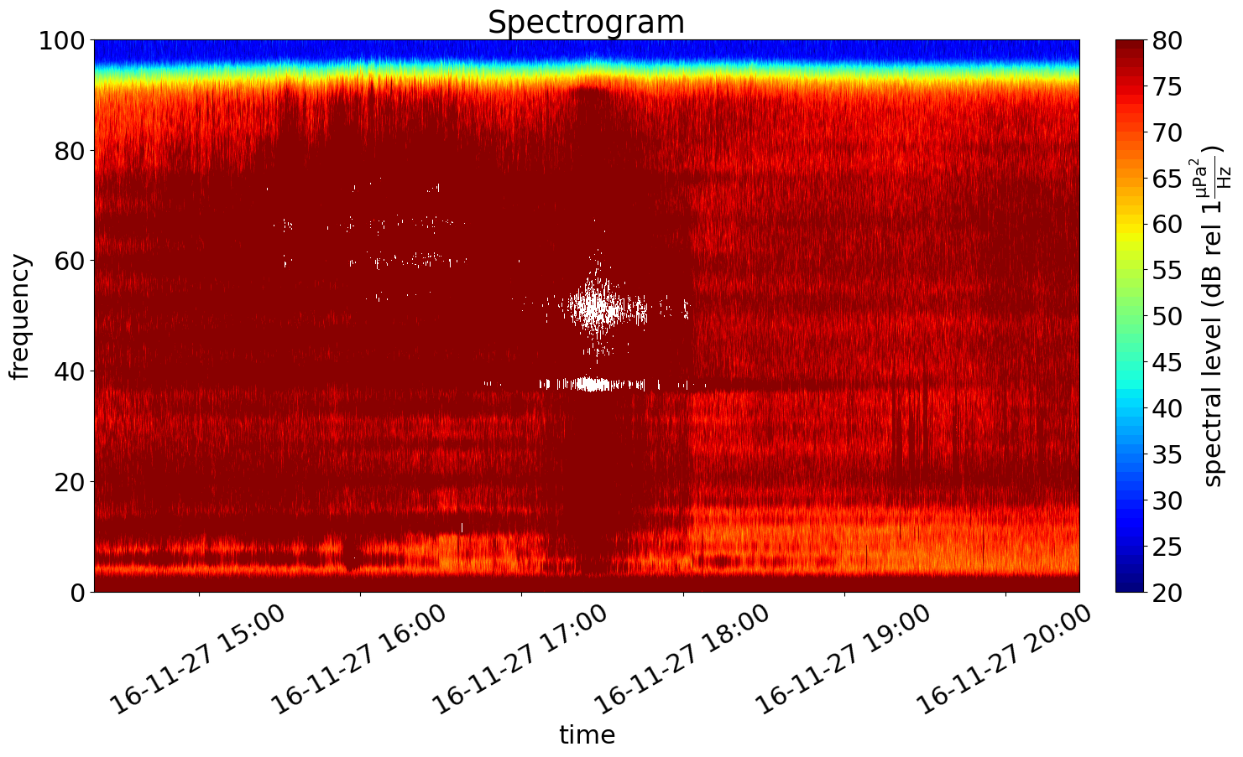
MMSI 538005544 CC
Start: 17:21:08
End: 17:27:37
3 hours before start and end

Slide 17
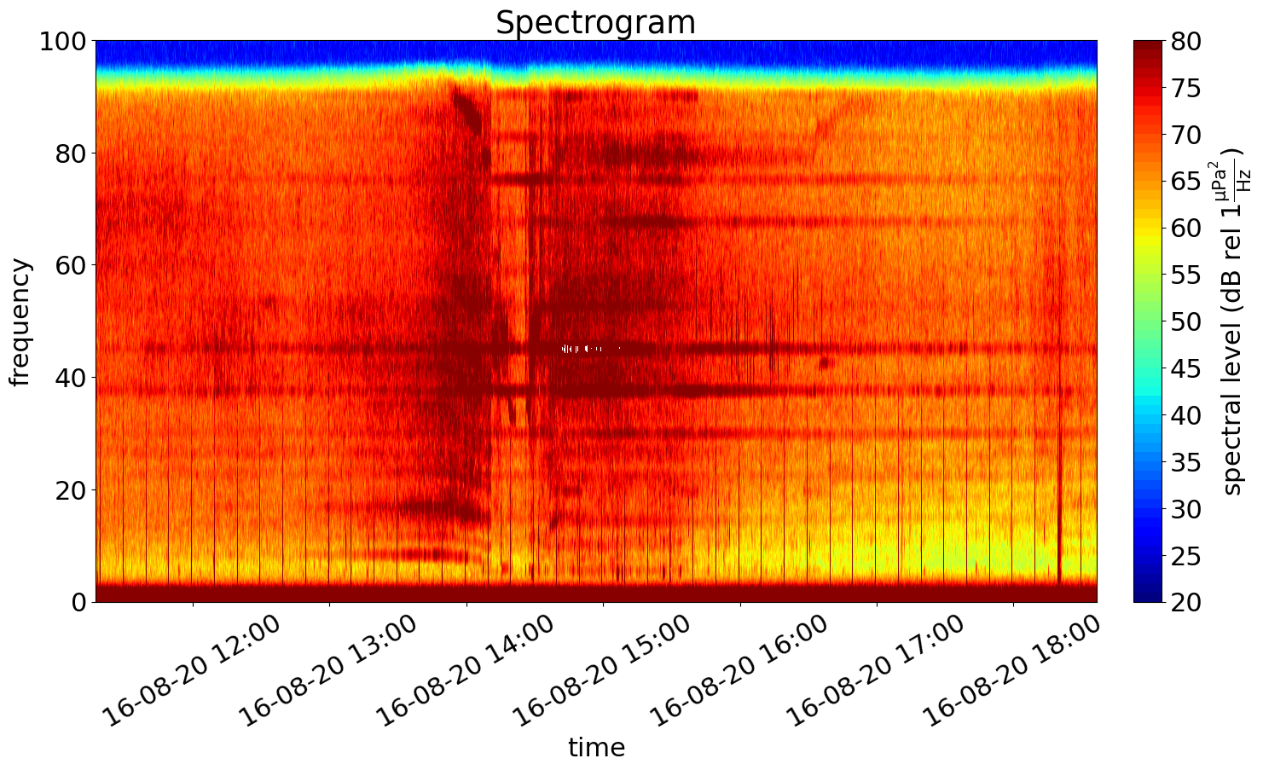
MMSI 352358000 AB
Start: 14:17:31
End: 15:36:41
3 hours before start and end

Slide 18
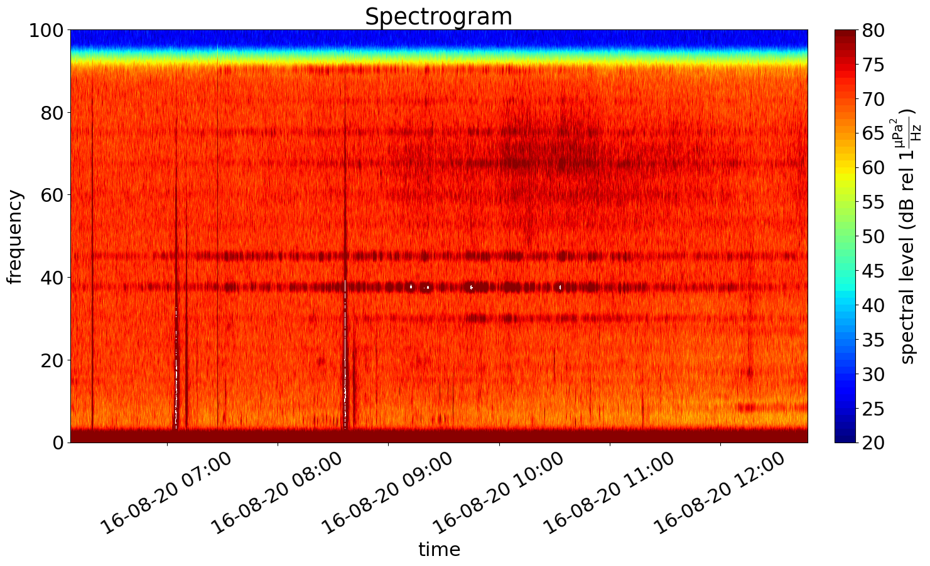
MMSI 352358000 CC
Start: 09:07:51
End: 09:47:19
3 hours before start and end

Slide 19
Rx level over Speed

Slide 20
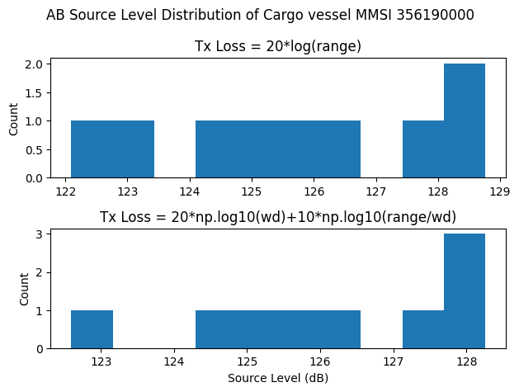
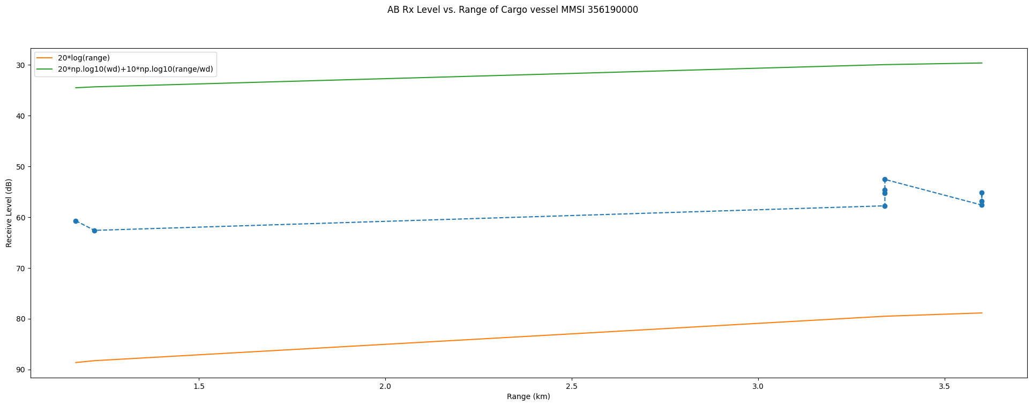
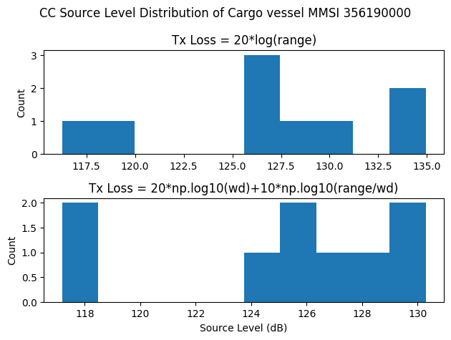
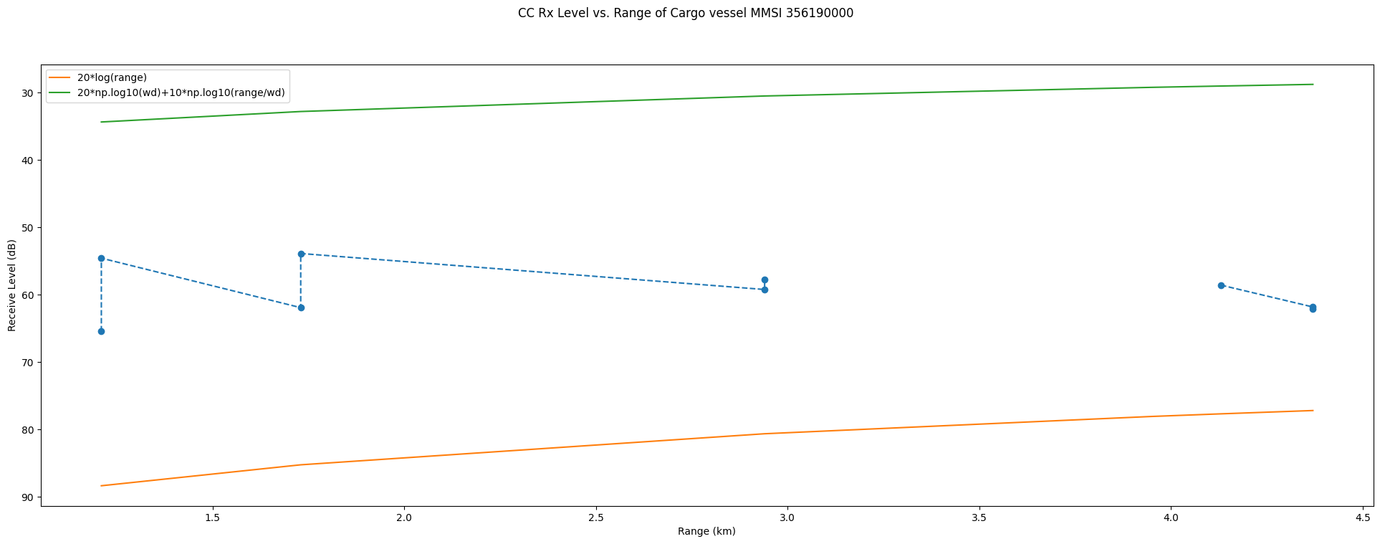
MMSI 356190000

Slide 21
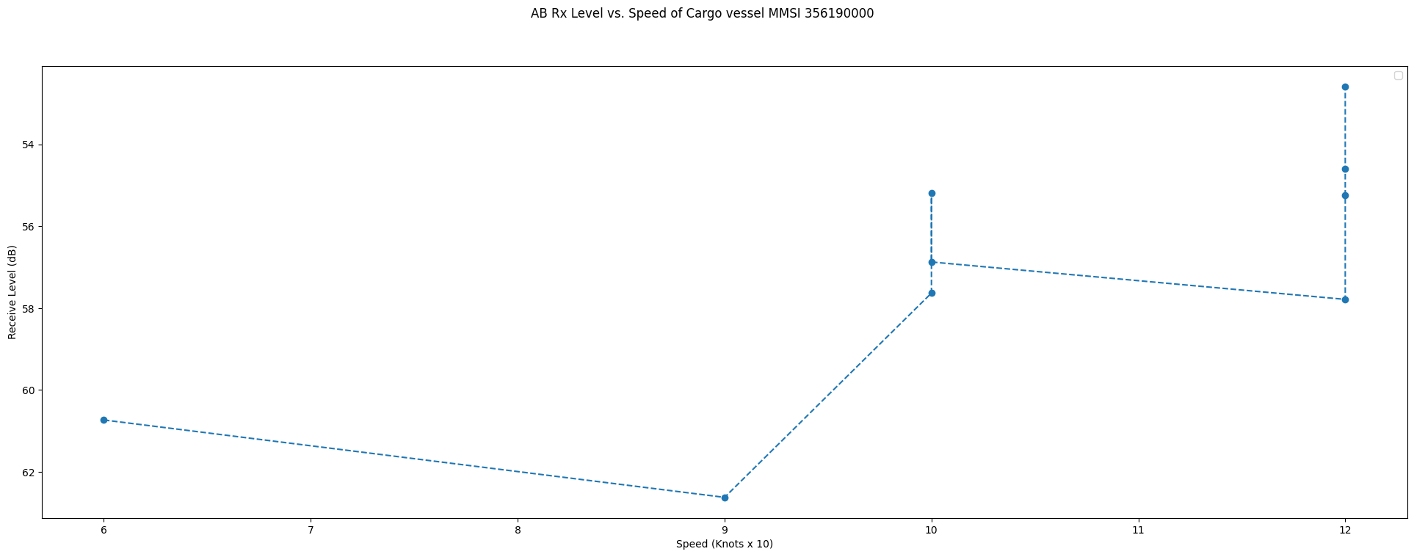
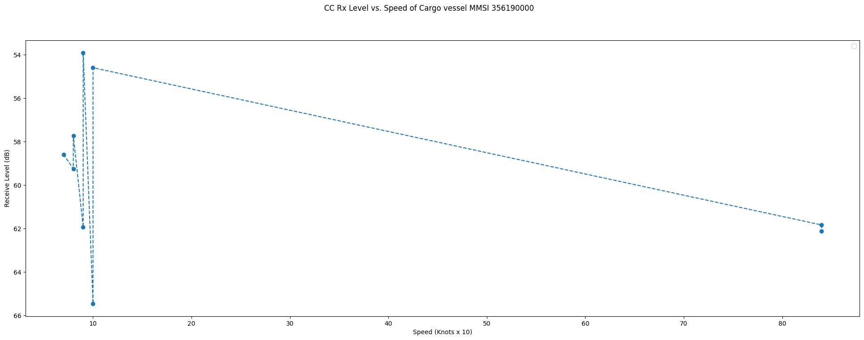
MMSI 356190000

Slide 22
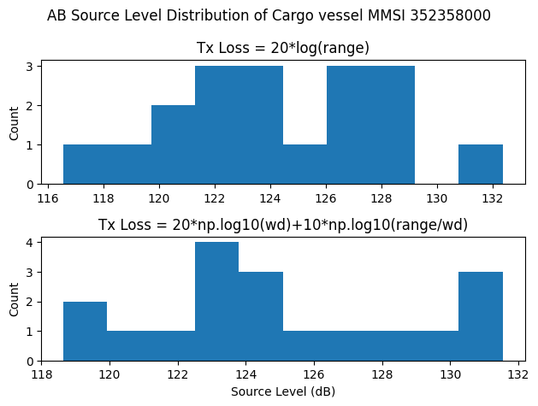
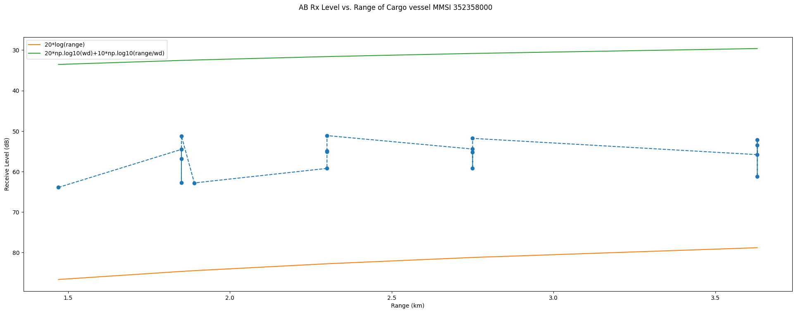
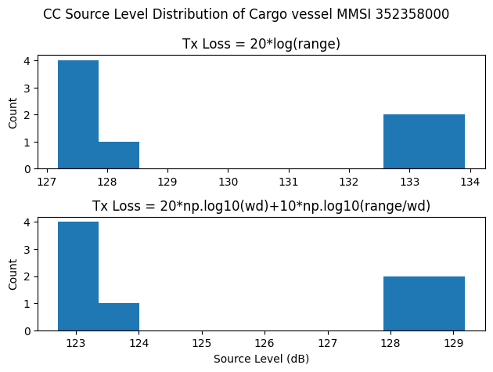
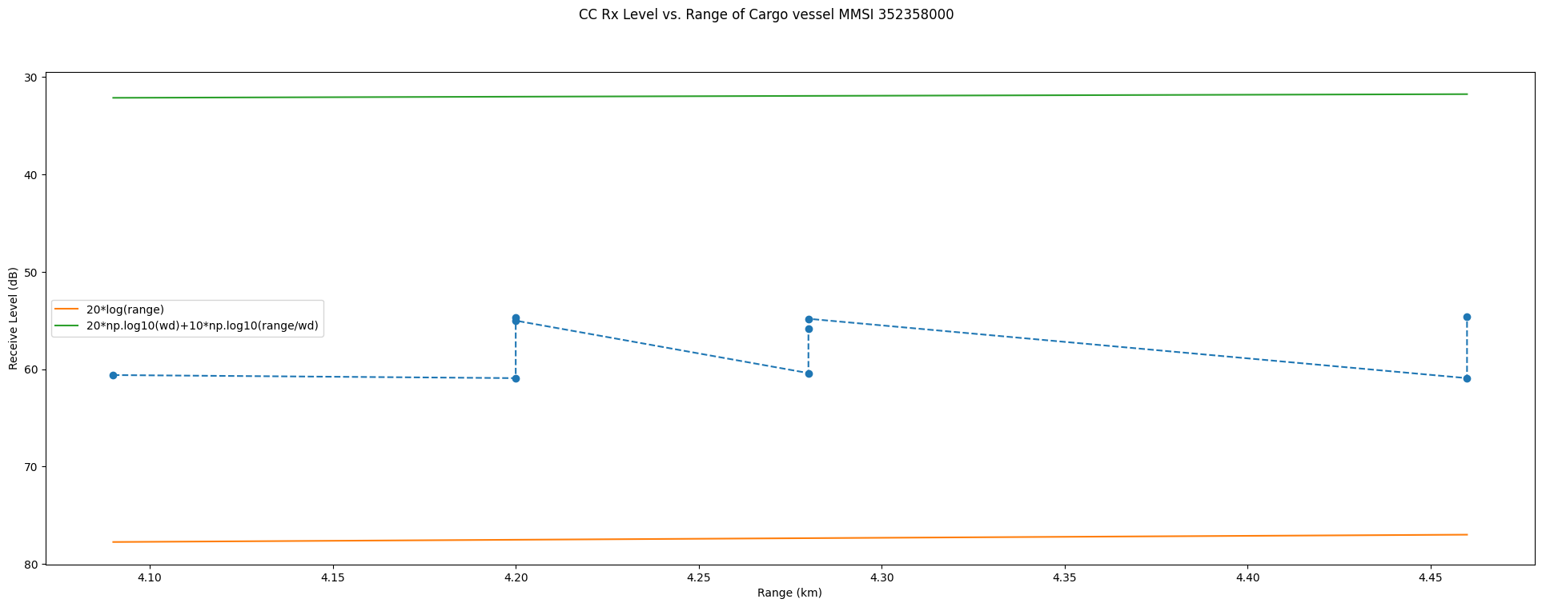
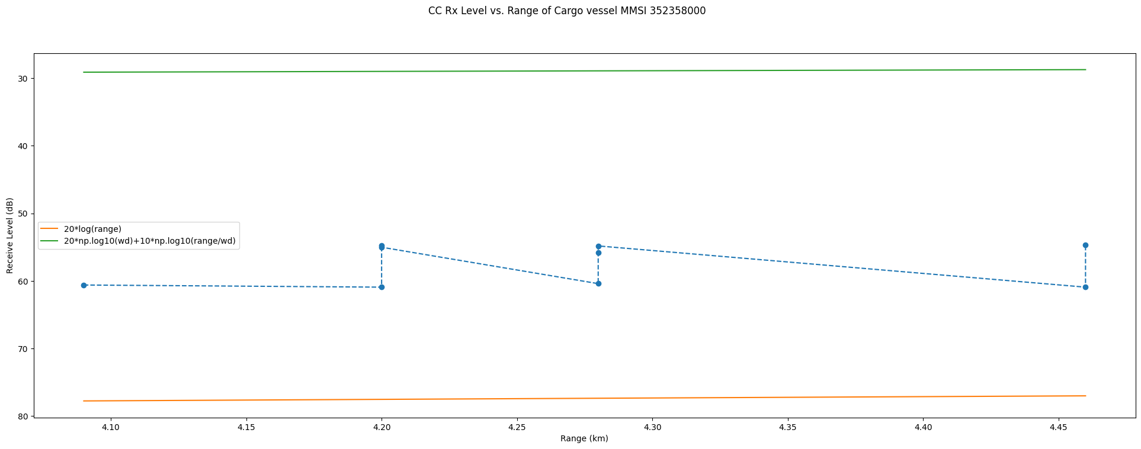
MMSI 352358000

Slide 23
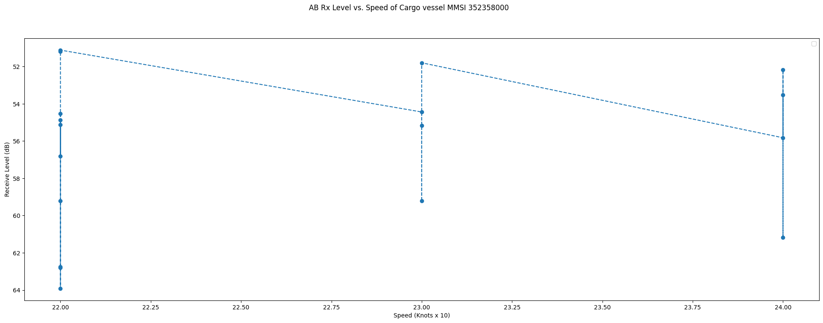
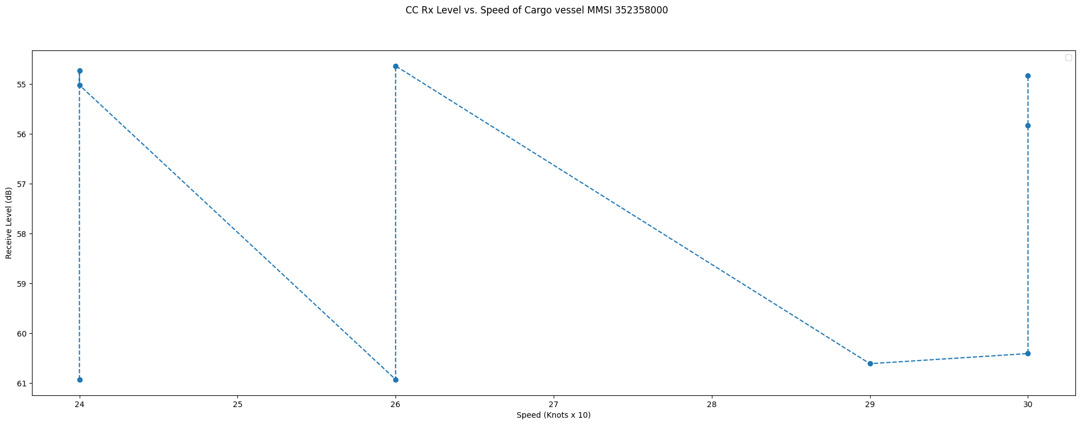
MMSI 352358000

Slide 24
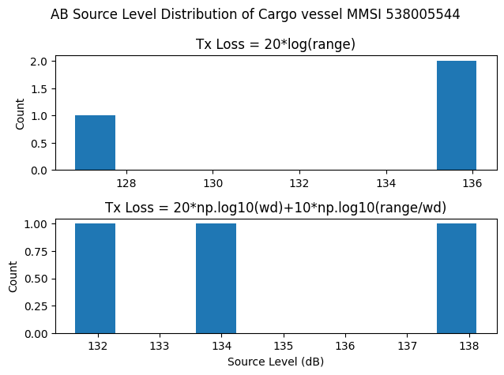
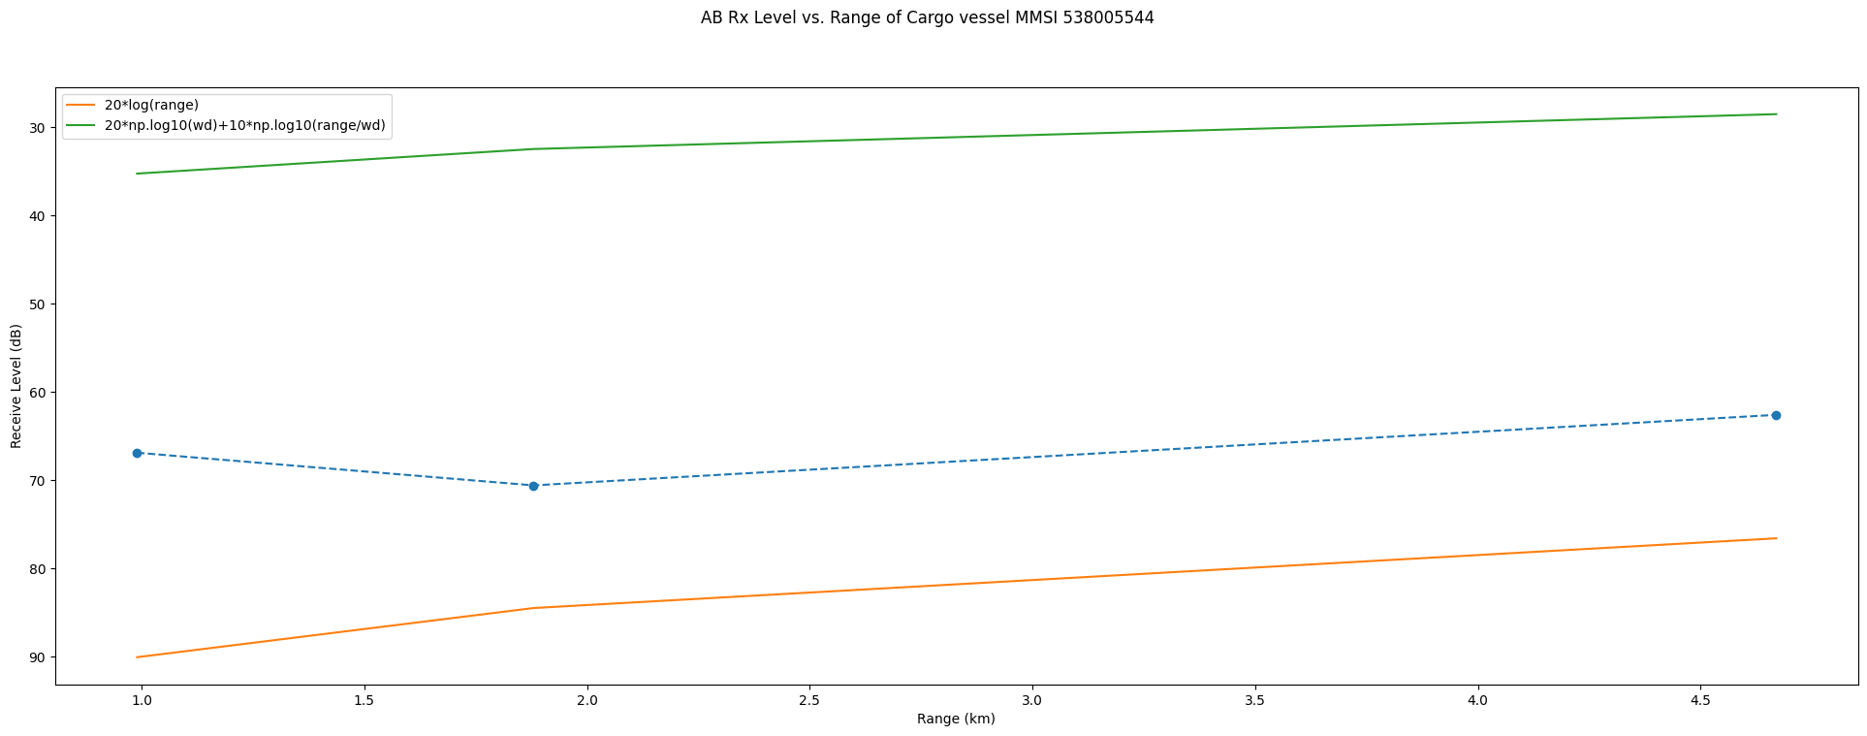
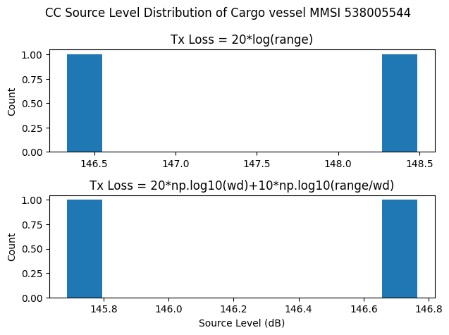
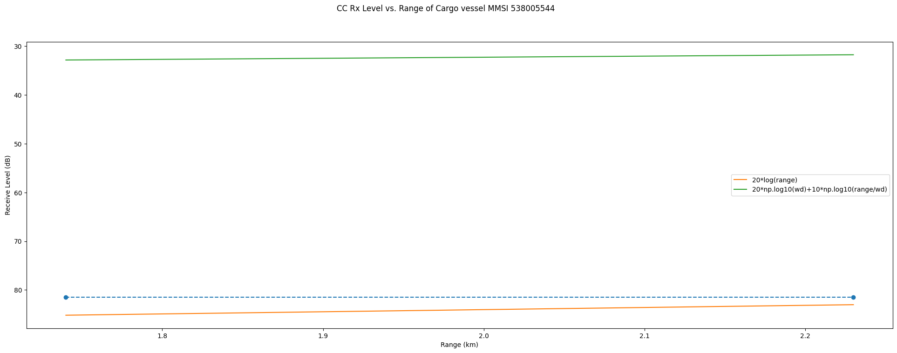
MMSI 538005544

Slide 25
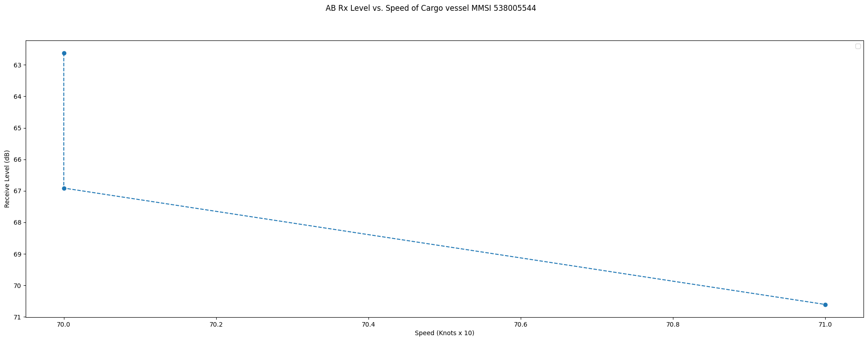
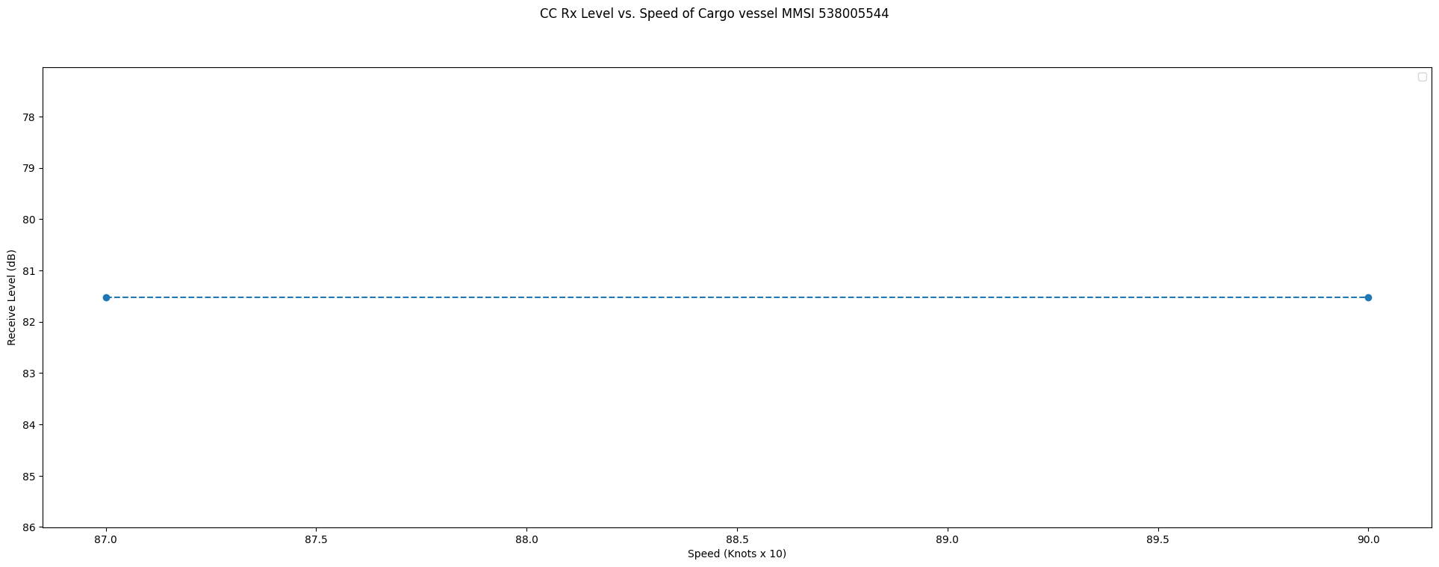
MMSI 538005544

Slide 26
Eastern Caldera Data
(Unable to query data from OOI for 2 rows)

Slide 27
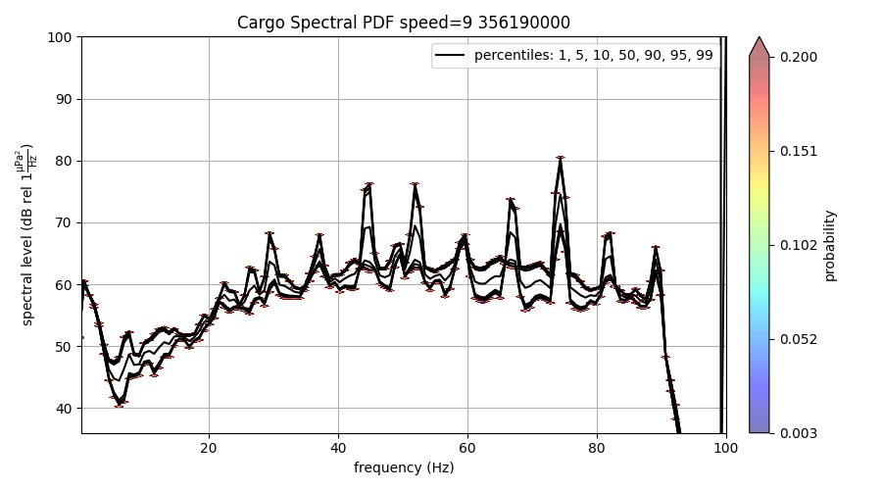
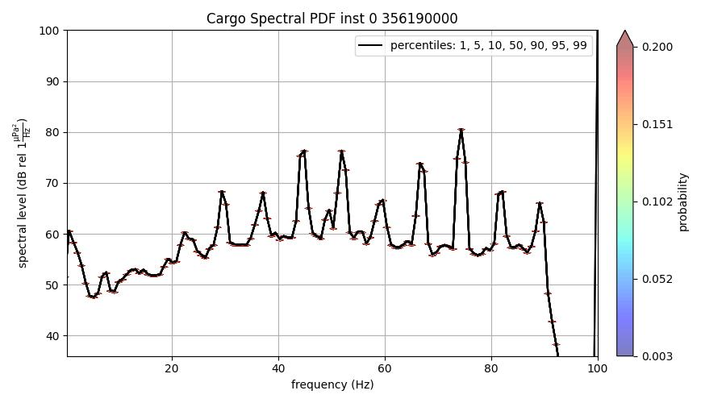
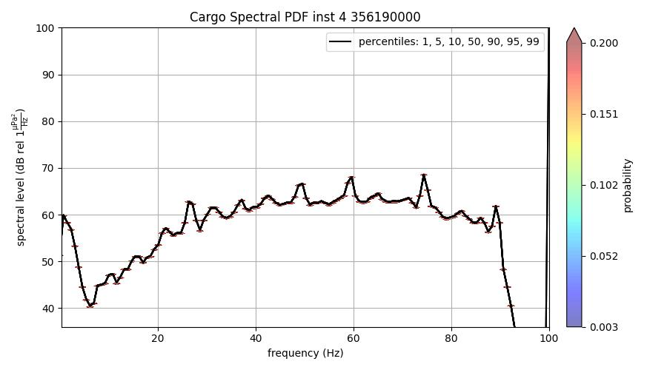
MMSI 356190000 EC
Speed: 0.9 knots
Range: 3.76 km
Inst 4 is repeated row but uses 2015 psd
Other PSD instances cannot be downloaded from OOI

Slide 28
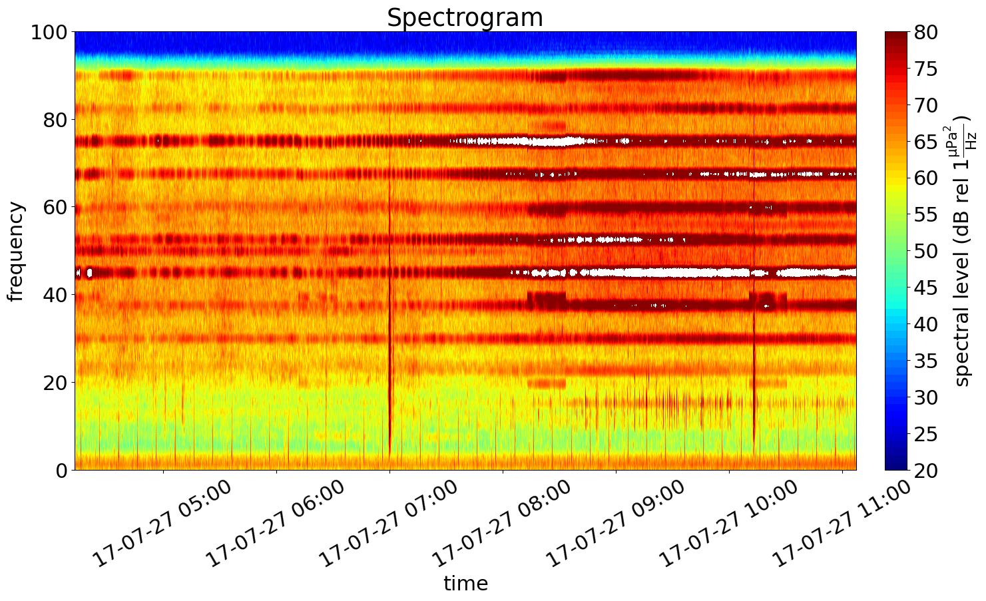
MMSI 356190000 EC

Slide 29
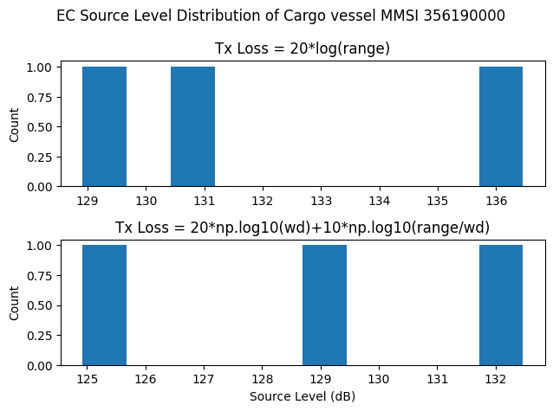
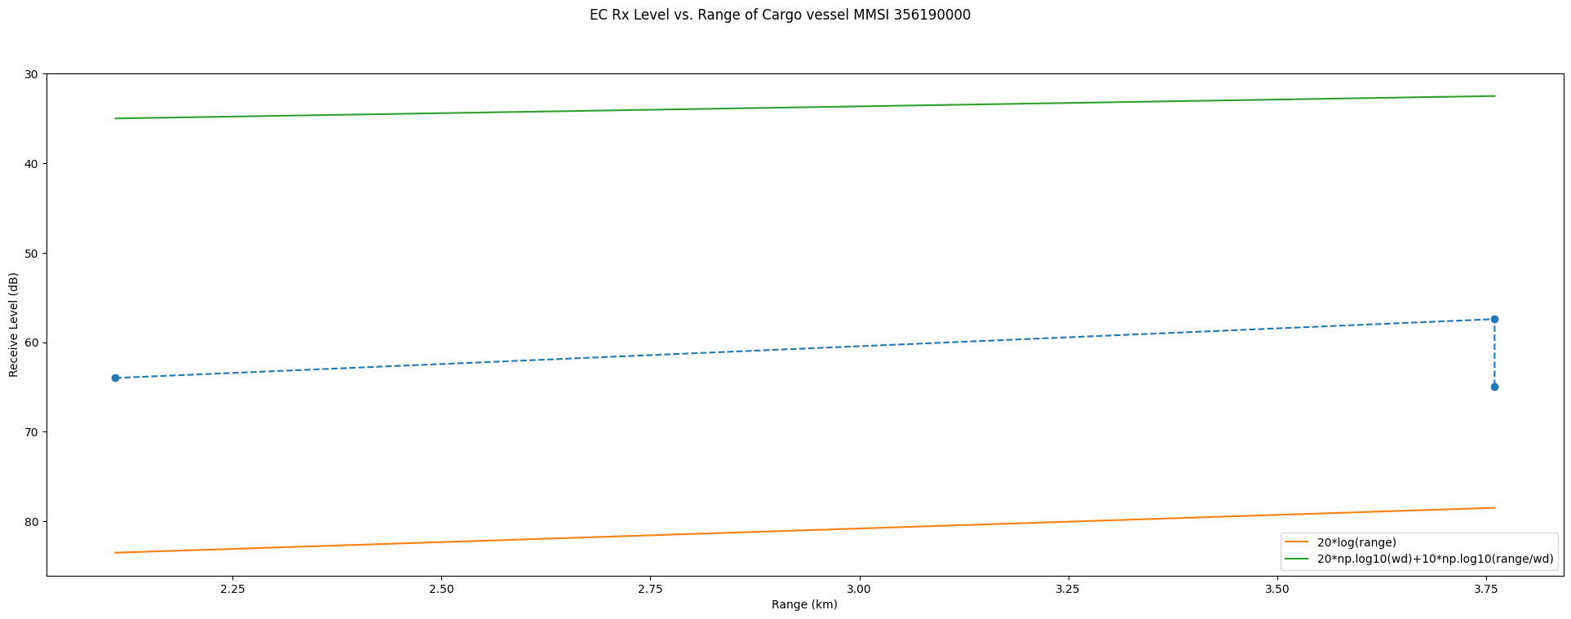
MMSI 356190000

Slide 30
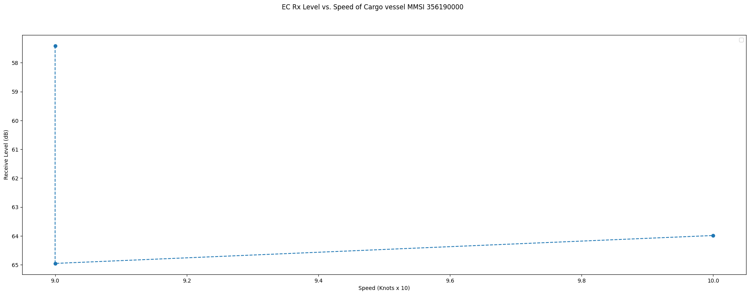
MMSI 356190000

Slide 31
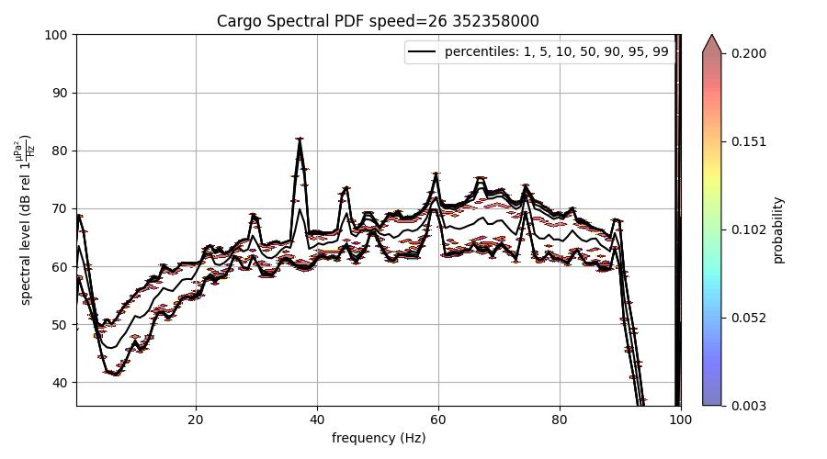
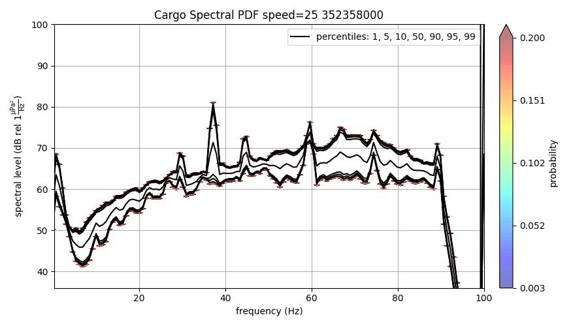
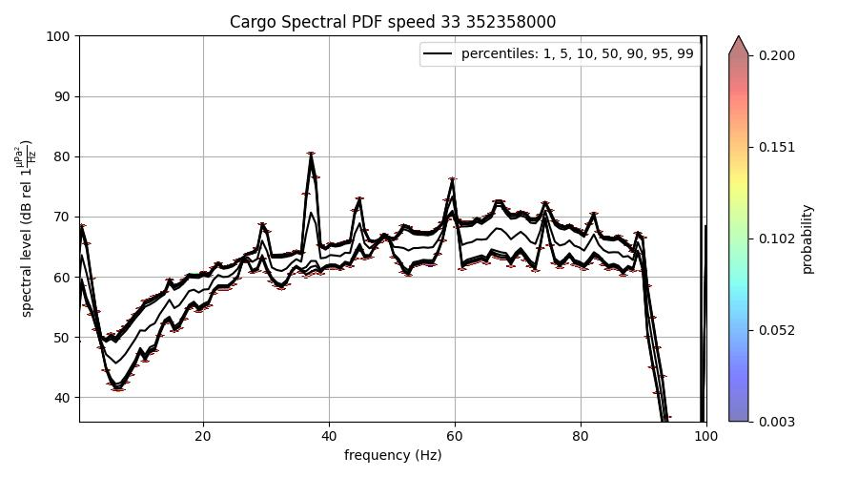
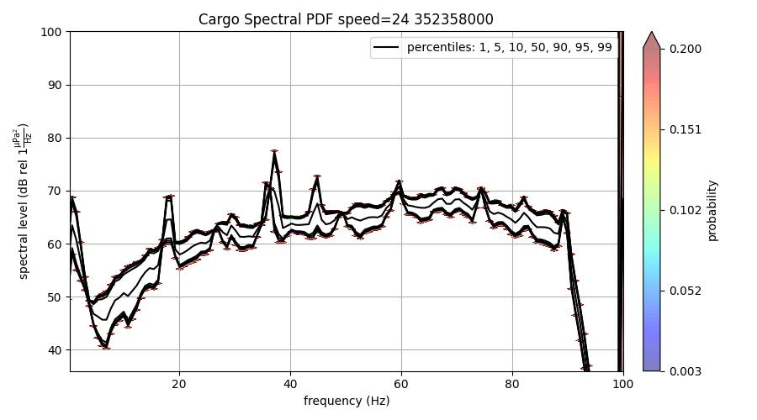
MMSI 352358000 EC
Speed: 2.6 knots
Range: 3.29-3.45 km
Speed: 2.5 knots
Range: 3.63 km
Speed: 3.3 knots
Range: 3.28 km
Speed: 2.4 knots
Range: 3.71 km

Slide 32
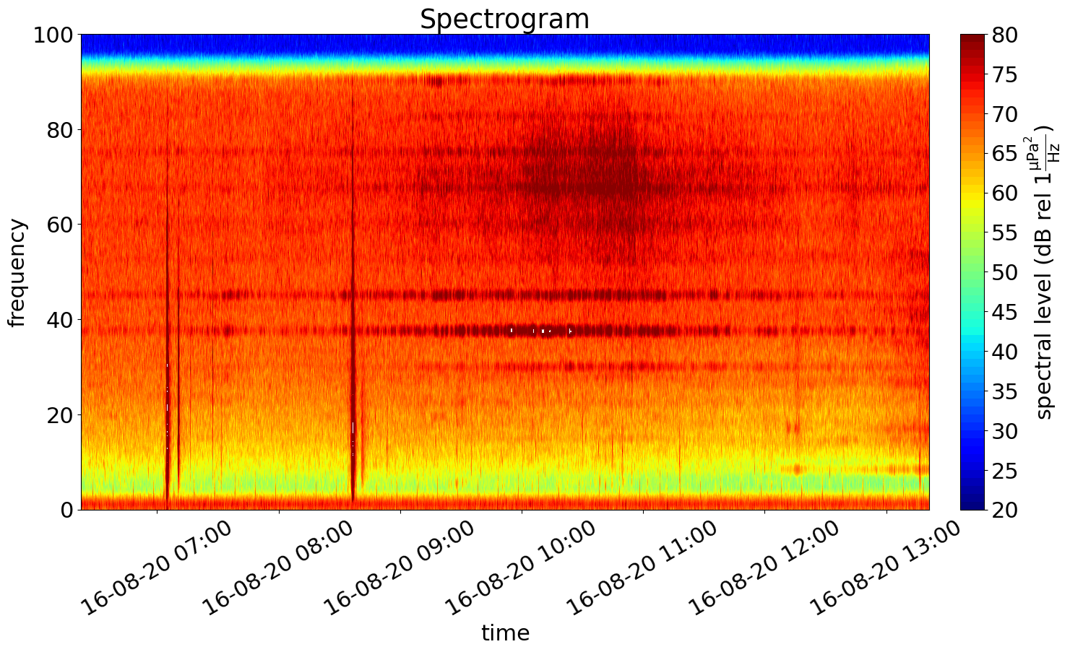
MMSI 352358000 EC

Slide 33


MMSI 352358000

Slide 34

MMSI 352358000

Slide 35




MMSI 538005544 EC
Speed: 9 knots
Range: 0.57-1.96 km
Speed: 9 knots
Range: 1.96 km
Speed: 8.7 knots
Range: 3.71 km
Speed: 9 knots
Range: 0.57 km

Slide 36


MMSI 538005544 EC

Slide 37


MMSI 538005544

Slide 38

MMSI 538005544

